Slide 1
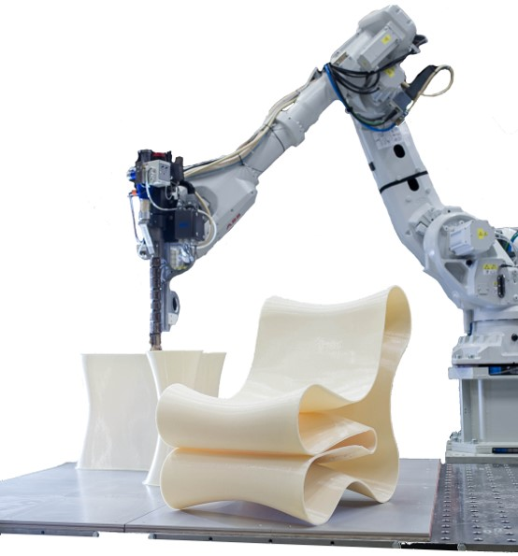

MINOR – ROBOTICS AND ARTIFICIAL INTELLIGENCE
COURSE – INTRODUCTION TO ROBOTICS (ME 201M)
MODULE 1
Dr. B. Sandeep Reddy
Assistant Professor, Mechanical Engineering, IIT Guwahati.
Email: bsandeepr@iitg.ac.in

Slide 2
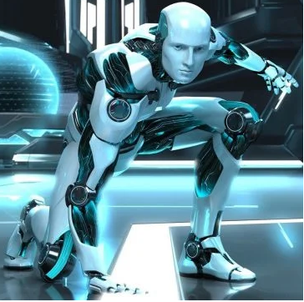
OVERVIEW OF MINOR PROGRAM
I – MECHANICS
IV – INTELLIGENCE (COGNITION)
INTRODUCTION TO ROBOTICS
(SEM III)
Fundamentals of Artificial
Intelligence(SEM VI)
THIS SEMESTER
II – SENSING (PERCEPTION)
III – CONTROL
MECHATRONICS
(SEM IV)
ROBOTIC VISION AND CONTROL (SEM V)

Slide 3
GRADING SCHEME
MidSem-20 %
End-Sem-30 %
Assignments–30%
Quizzes–20%

Slide 4
ROUGH OUTLINE OF THE COURSE
MODULE 1 (~11 Lectures)
Links and Joints, DOF
Spatial Descriptions – Position and Orientation, Homogeneous Transformations
Different Methods of describing orientation of a rigid body
DH Parameters
Actuation, Transmission and Sensors
MODULE 2 (~12 Lectures)
Serial Robots – Forward and Inverse Kinematics
Velocity and Static analysis of manipulators
Mechanism Design
MODULE 3 (~16 Lectures)
Trajectory planning
Dynamics of robots
MODULE 4 (~ 6 Lectures)
Parallel robots

Slide 5
TEXTBOOKS
Fu. K.S., Gonzalez R.C. and Lee C.S.G., Robotics: Control, Sensing, Vision and Intelligence, Tata McGraw Hill, 2008.
Ghosal A. Robotics: Fundamental Concepts and Analysis, Oxford University Press, 2006.
Craig J.J., Introduction to Robotics – Mechanics and Control, Pearson Prentice Hall, 2005.
Saha. S.K., Introduction to Robotics, McGraw Hill Education (India) Private Limited, 2014.
Spong M.W., Hutchinson S. and Vidyasagar M., Robot Modeling and Control, John Wiley Sons & Inc., 2005.

Slide 6
OVERVIEW OF KINEMATICS
MODULE 1 – LECTURE 1
OVERVIEW OF KINEMATICS

Slide 7
OVERVIEW OF KINEMATICS OF MACHINES
A DEVICE FOR TRANSFERRING AND TRANSFORMING MOTION AND FORCE FROM A SOURCE TO THE LOAD
WHAT IS A MACHINE ??
Motion needs to be transformed as it is being transferred from the source to the load
Type of Transformation needed – decided by available input motion and desired output motion
AVAILABLE INPUT MOTION | DESIRED OUTPUT MOTION
Continuous Rotation | Rectilinear Motion
Rectilinear Motion | Continuous Rotation
Continuous Rotation | To and Fro Oscillation
To and Fro Oscillation | Continuous Rotation
Continuous Rotation (Different Speed) | Continuous Rotation (Different Speed)
Continuous Rotation | Angular Oscillation
OVERVIEW OF KINEMATICS

Slide 8
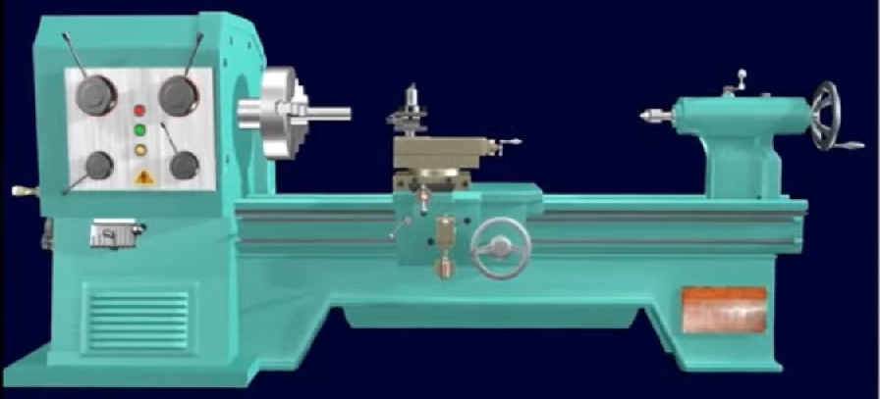
Input motion is available at shaft of driving motor
This motion has to be transferred to two different locations, (i) headstock, to provide motion to the job (ii) tool post, to provide motion to the cutting tool
LATHE
WHAT KIND OF TRANSFORMATION IS TAKING PLACE HERE ??
The job has to rotate continuously. So, the head stock has to be rotated at different speed than for the input motor, depending on the size of the job, whereas the tool post has to move along a straight line starting from the same input motion.
Thus, we need to have different kinds of devices to transfer and transform from the input to the output.
OVERVIEW OF KINEMATICS

Slide 9
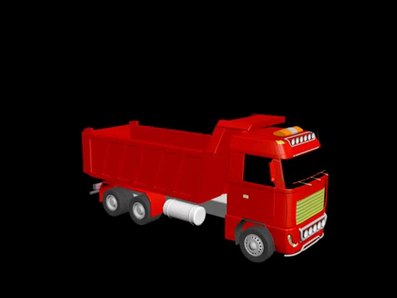
WHAT IS KINEMATICS ??
Input motion is linear – provided by hydraulic actuator and has to be transformed into rotary motion of dumping bin.
linear motion at the hydraulic actuator from the input side is transferred to the bin and is also transformed into the rotary motion
Within paradigm of rigid body, relative motion between various components can be studied from the view point of geometric constraints without any reference to force
Various components undergo little deformation – can be assumed as rigid
deals with geometric constraint of relative motion, without any reference to the cause of the motion
KINEMATICS
OVERVIEW OF KINEMATICS

Slide 10
For the study of kinematics, a machine may be referred to as a mechanism
combination of interconnected rigid bodies capable of relative motion
MECHANISM
During the study of kinematics that is of a mechanism, the idea of motion or relative motion predominates and the idea of force takes a back seat.
 | Machine | Mechanism
Predominant Idea | force, torque, work, and power | achieving a desired motion
Can be contrasted with a “structure” - structure is also a combination of resistant (rigid) bodies connected by joints, but the purpose of a structure (such as a truss) is not to do work or to transform motion, but to be rigid.
“Structure” is to statics as “mechanism” is to kinematics as “machine” is to kinetics
OVERVIEW OF KINEMATICS

Slide 11
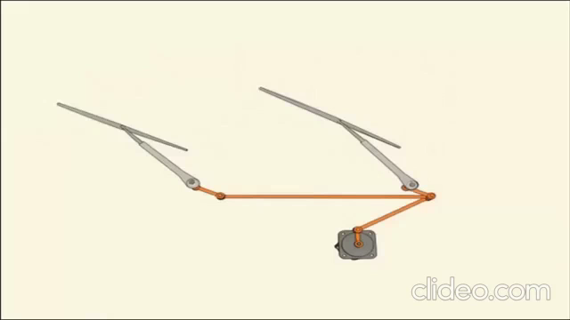
deals with only geometric aspects of motion without any consideration of force
KINEMATICS
combination of interconnected rigid bodies capable of relative motion
MECHANISM
Power available at the motor shaft is used to overcome the friction force between the blade and the wind screen.
However, the designer is primarily interested to ensure a proper range of oscillation of the wiper blade, to generate the desired field of wiping.
Hence, it is not called a wiper machine, but a wiper mechanism
The continuous rotation of the drive motor is converted into to and fro oscillation of the wiper blade
OVERVIEW OF KINEMATICS

Slide 12
How Mechanisms behave depends upon the interconnection amongst members of the mechanism
These Interconnections are called kinematic pairs
What are the various types of kinematic pairs and what kind of relative motion do they permit ?
Number of coordinates needed to describe relative motion permitted in a kinematic pair
Degree of Freedom (DOF)
The coordinates that are used to describe this relative movement are called pair variables
Rigid Body is connected to another rigid body
Kinematic Pair
one or more of the 6 DOF are curtailed and only a few are retained
Unconstrained Rigid Body – 6 DOF
OVERVIEW OF KINEMATICS

Slide 13
KINEMATIC PAIR
LOWER PAIR
WRAPPING PAIR
HIGHER PAIR
One Body wraps over the other. Eg. Belt wrapping around pulley or chain wrapping around sprocket
Bodies connected have line or point contact
Bodies connected have area contact
OVERVIEW OF KINEMATICS

Slide 14
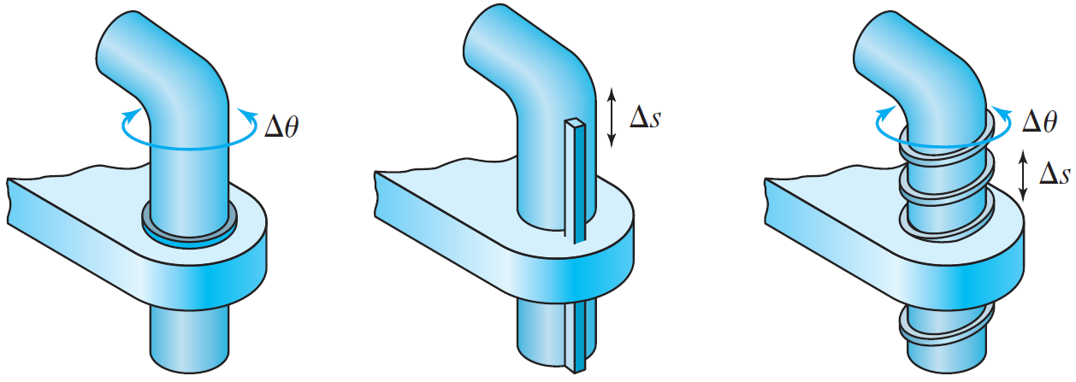
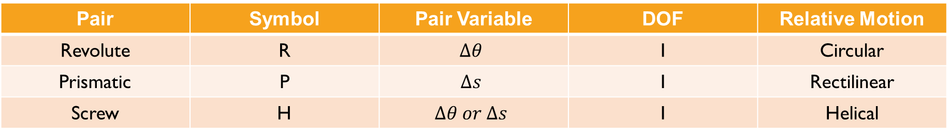
LOWER PAIRS
REVOLUTE PAIR
SCREW PAIR
PRISMATIC PAIR
Pair | Symbol | Pair Variable | DOF | Relative Motion
Revolute | R | $$Δθ$$ | 1 | Circular
Prismatic | P | $$Δs$$ | 1 | Rectilinear
Screw | H | $$Δθ or Δs$$ | 1 | Helical
OVERVIEW OF KINEMATICS

Slide 15
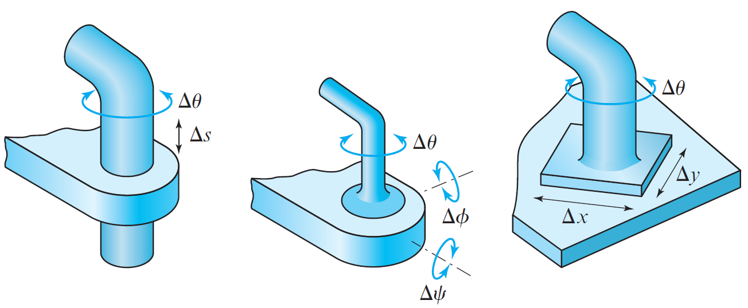
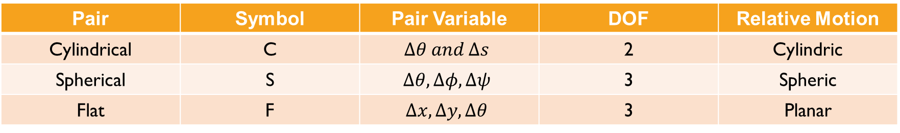
LOWER PAIRS
CYLINDRICAL PAIR
SPHERICAL PAIR
FLAT PAIR
Pair | Symbol | Pair Variable | DOF | Relative Motion
Cylindrical | C | $$Δθ and Δs$$ | 2 | Cylindric
Spherical | S | $$Δθ, Δφ, Δψ$$ | 3 | Spheric
Flat | F | $$Δx, Δy, Δθ$$ | 3 | Planar
OVERVIEW OF KINEMATICS

Slide 16
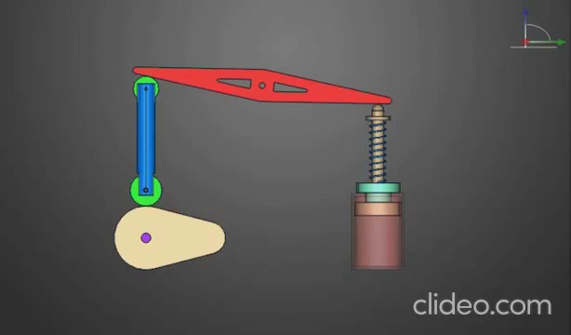
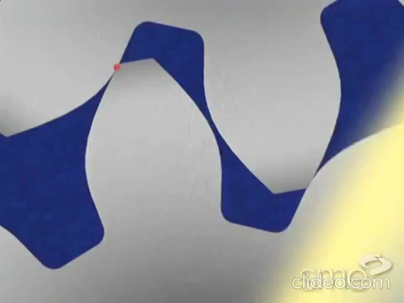
HIGHER PAIRS
Contact between the two bodies takes place only along a line or at a point
CAM-FOLLOWER MECHANISM
MATING GEAR TEETH
OVERVIEW OF KINEMATICS

Slide 17
ANOTHER WAY OF CLASSIFYING KINEMATIC PAIRS
FORM-CLOSED PAIR
FORCE-CLOSED PAIR
contact between the two bodies at the kinematic pair is maintained by the geometric form
Contact needs to be maintained by the application of an external force
OVERVIEW OF KINEMATICS

Slide 18
MECHANISMS
PLANAR
SPHERICAL
SPATIAL
OVERVIEW OF KINEMATICS

Slide 19
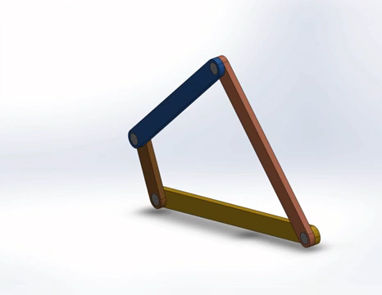

PLANAR MECHANISMS
all the points of the mechanism move in parallel planes
all these parallel planes can be represented by a single plane, (the plane of motion)
A single view perpendicular to this plane of motion reveals the true motion of all the points of a mechanism
OVERVIEW OF KINEMATICS

Slide 20
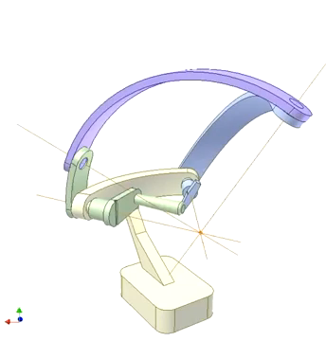
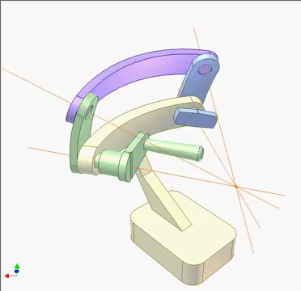
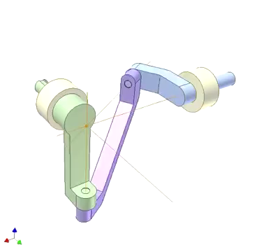
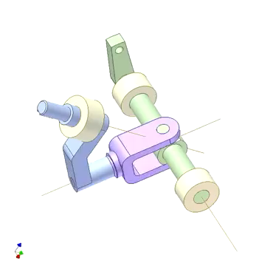
SPHERICAL MECHANISMS
OVERVIEW OF KINEMATICS

Slide 21
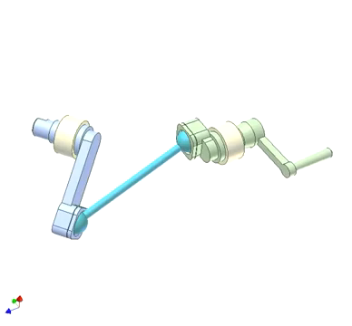
SPATIAL MECHANISMS
4-R Spatial Linkage
points of all these links move neither in parallel planes nor on the surfaces of spheres, but in 3D space.
they are neither intersecting nor parallel
unlike in a 4R-planar linkage or in a 4R spherical linkage, in this 4R-Spatial linkage, there can be relative motion only for specific dimensions
OVERVIEW OF KINEMATICS

Slide 22
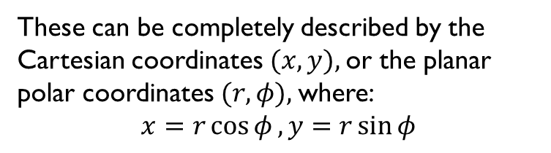
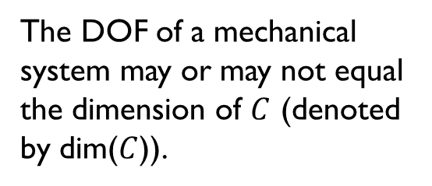
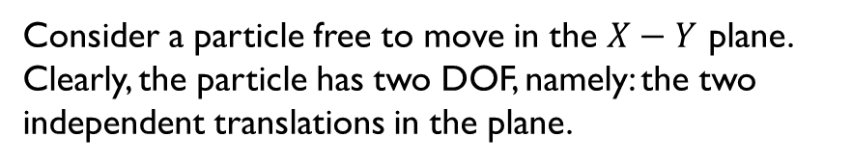
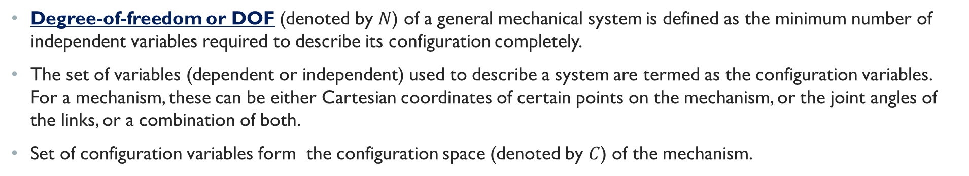

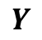

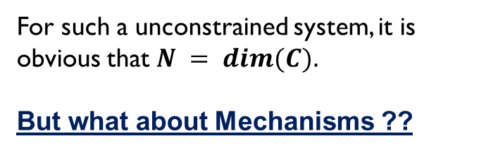
DEGREES OF FREEDOM
Degree-of-freedom or DOF (denoted by $N$) of a general mechanical system is defined as the minimum number of independent variables required to describe its configuration completely.
The set of variables (dependent or independent) used to describe a system are termed as the configuration variables. For a mechanism, these can be either Cartesian coordinates of certain points on the mechanism, or the joint angles of the links, or a combination of both.
Set of configuration variables form the configuration space (denoted by $C$) of the mechanism.
These can be completely described by the Cartesian coordinates $(x, y),$or the planar polar coordinates $(r, φ),$where:
$$x=r\cos{φ}, y=r\sin{φ}$$
$$Y$$
The DOF of a mechanical system may or may not equal the dimension of $C$ (denoted by dim($C$)).
$$P$$
For such a unconstrained system, it is obvious that $N = dim⁡(C).$
But what about Mechanisms ??
$$X$$
Consider a particle free to move in the $X−Y$ plane. Clearly, the particle has two DOF, namely: the two independent translations in the plane.
OVERVIEW OF KINEMATICS

Slide 23
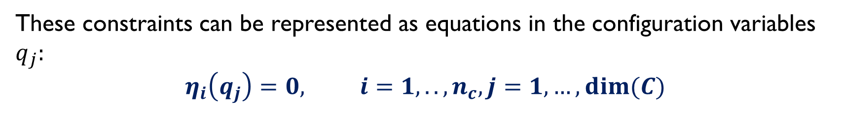


MECHANISMS $→$ TYPICALLY CONSTRAINED
$$N =dim\left(C\right)−n_{c}$$
Independent holonomic constraints
These constraints can be represented as equations in the configuration variables $q_{j}:$
$$η_{i}\left(q_{j}\right)=0, i=1,..,n_{c}, j=1,…,dim⁡(C)$$
OVERVIEW OF KINEMATICS

Slide 24




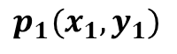
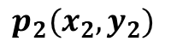
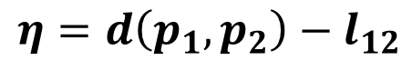

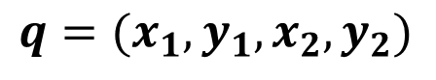
DOF of planar Mechanisms
Beginning from just an isolated point to a planar mechanism in a sequence of steps, each step can be analyzed individually
Description of System
$$Y$$
$$p_{2}(x_{2},y_{2})$$
$$φ$$
$$q=(x_{1},y_{1},x_{2},y_{2})$$
$$l_{12}$$
$$η=d\left(p_{1},p_{2}\right)−l_{12}$$
$$p_{1}(x_{1},y_{1})$$
$$⇒{\left(x_{1}−x_{2}\right)}^{2}+{\left(y_{1}−y_{2}\right)}^{2}−l_{12}^{2}$$
$$X$$
$$We have,\dim\left(C\right)=4, n_{c}=1, N=4−1=3$$
$$O$$
Description of the system therefore admits three independent variables.
$$q\left(x_{1},y_{1}, φ\right) or equivalently q\left(x_{2},y_{2}, φ\right)$$
OVERVIEW OF KINEMATICS

Slide 25

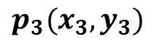
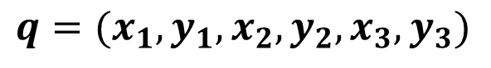





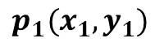
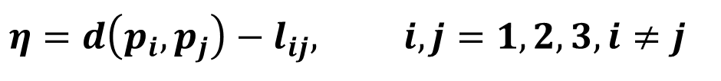
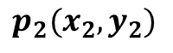

RIGID BODY IN A PLANE
A rigid-body confined to a plane has no more degrees-of-freedom than a line embedded in it. In other words, it is enough to specify the coordinates of two points on the body in order to describe its configuration completely.
Introducing third point $p_{3}(x_{3},y_{3})$ non-collinear with segment$p_{1}p_{2}$
$$Y$$
$$p_{2}(x_{2},y_{2})$$
$$φ$$
$$q=(x_{1},y_{1},x_{2},y_{2},x_{3},y_{3})$$
$$l_{12}$$
$$l_{23}$$
$$l_{31}$$
$$η=d\left(p_{i},p_{j}\right)−l_{ij}, i,j=1,2,3, i≠j$$
$$p_{3}(x_{3},y_{3})$$
$$p_{1}(x_{1},y_{1})$$
$$We have,\dim\left(C\right)=2×3=6, n_{c}=3, N=6−3=3$$
$$X$$
$$O$$
OVERVIEW OF KINEMATICS

Slide 26

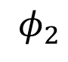
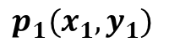
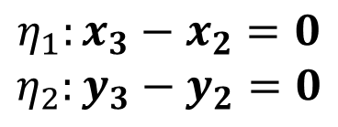
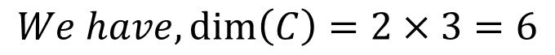
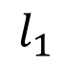
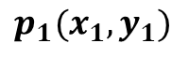
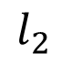
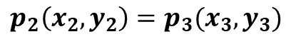
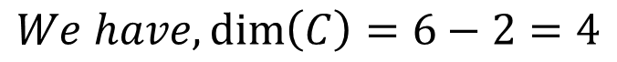
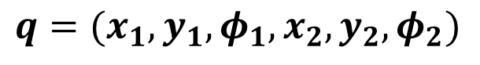

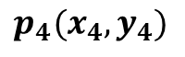
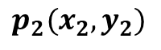
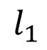
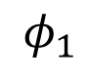


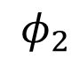
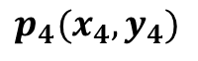
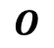





System of links IN A PLANE
Consider two freely floating links
$$p_{4}(x_{4},y_{4})$$
$$Y$$
$$φ_{2}$$
$$l_{2}$$
$$Y$$
$$p_{1}(x_{1},y_{1})$$
creating an open chain of two links
$$l_{1}$$
$$l_{2}$$
$$φ_{1}$$
$$p_{2}\left(x_{2},y_{2}\right)=p_{3}(x_{3},y_{3})$$
$$p_{4}(x_{4},y_{4})$$
$$φ_{1}$$
$$l_{1}$$
$$φ_{2}$$
$$η_{1}:x_{3}−x_{2}=0$$
$$η_{2}:y_{3}−y_{2}=0$$
$$p_{1}(x_{1},y_{1})$$
$$p_{2}(x_{2},y_{2})$$
$$p_{3}(x_{3},y_{3})$$
$$X$$
$$O$$
$$X$$
$$O$$
$$We have,\dim\left(C\right)=6−2=4$$
$$q=(x_{1},y_{1},φ_{1},x_{2},y_{2},φ_{2})$$
It is convenient to think of these DOF as being reflected as the configuration of the lower link, and the relative rotation, $θ=φ_{2}−φ_{1}$ of the upper link with respect to the lower one.
$$We have,\dim\left(C\right)=2×3=6$$
OVERVIEW OF KINEMATICS

Slide 27












Consider that the chain is tethered to a point $p_{g}(x_{g}, y_{g})$ on the plane.
$$p_{4}(x_{4},y_{4})$$
Additional pair of constraints imposed
$$θ_{2}$$
$$Y$$
$$l_{2}$$
$$η_{1}:x_{1}−x_{g}=0$$
$$η_{2}:y_{1}−y_{g}=0$$
$$l_{1}$$
$$p_{2}\left(x_{2},y_{2}\right)=p_{3}(x_{3},y_{3})$$
$$θ_{1}$$
WHAT IS THE DOF IN THIS CASE ??
$$p_{1}\left(x_{1},y_{1}\right)=p_{g}(x_{g},y_{g})$$
$$O$$
$$X$$
The last pair of constraints essentially kill the translational DOF of the lower link.
Its remaining degree-of-freedom can be conveniently described by the joint angle $θ_{1}=φ_{1}$
OVERVIEW OF KINEMATICS

Slide 28



DEGREES OF FREEDOM
$Gr\ddot{u}bler−Kutzbach Criterion$
$$DOF=λ\left(N−J−1\right)+\sum_{i=1}^{J}{F_{i}}$$
N – Total number of links including the fixed link (or base),
J – Total number of joints connecting only two links (if joint connects three links then it must be counted as two joints),
$F_{i}$ – Degrees of freedom at the $i^{th}$ joint, and $λ=6$for spatial, $λ=3$ for planar manipulators and mechanisms.
Grübler criterion does not work for over-constrained mechanisms (known result from “Mavroidas and Roth(1995), Gan and Pellegrino(2003), review paper by Gogu(2007)).”
PUMA 560 Robot
$$N=7, J=6, F_{1}=1, λ=6$$
$$→DOF=6$$
OVERVIEW OF KINEMATICS

